Slide 1
FDE Midterm Report
Name Display, UFDE & Rabbit, SMIMS Engine, FDE-CLI, I2C
Jimmy Wang (王俊崴) 22302016002
Notes:
Good afternoon, everyone, my name is Jimmy Wang from software engineering, and this is my FDE midterm report.

Slide 2
Agenda
Experiment 1: Name Display
Experiment 2: Introduction
SMIMS VLFD Driver in Rust
SMIMS Engine
FDE-CLI
I2C
Notes:
This is the rough agenda for today.
I will briefly talk about the first name display experiment, and then move on to experiment 2 which consists of two parts: a software part, and hardware part.

Slide 3
Name Display
Objective
Display our name on the 7-segment text LCD
Methodology
Generate the Verilog code for each
For each sentence
Generate a Verilog case block that assigns values to temporary registers (tmp0, tmp1, …)
A multiplexer selects which sentence (temporary register) to display

Slide 4
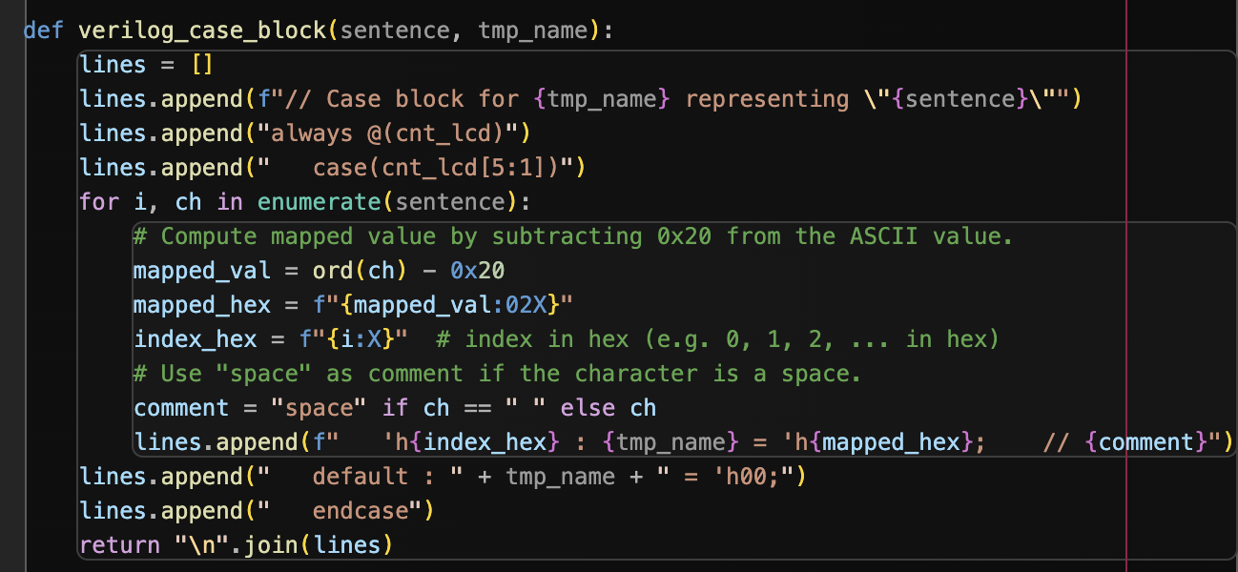
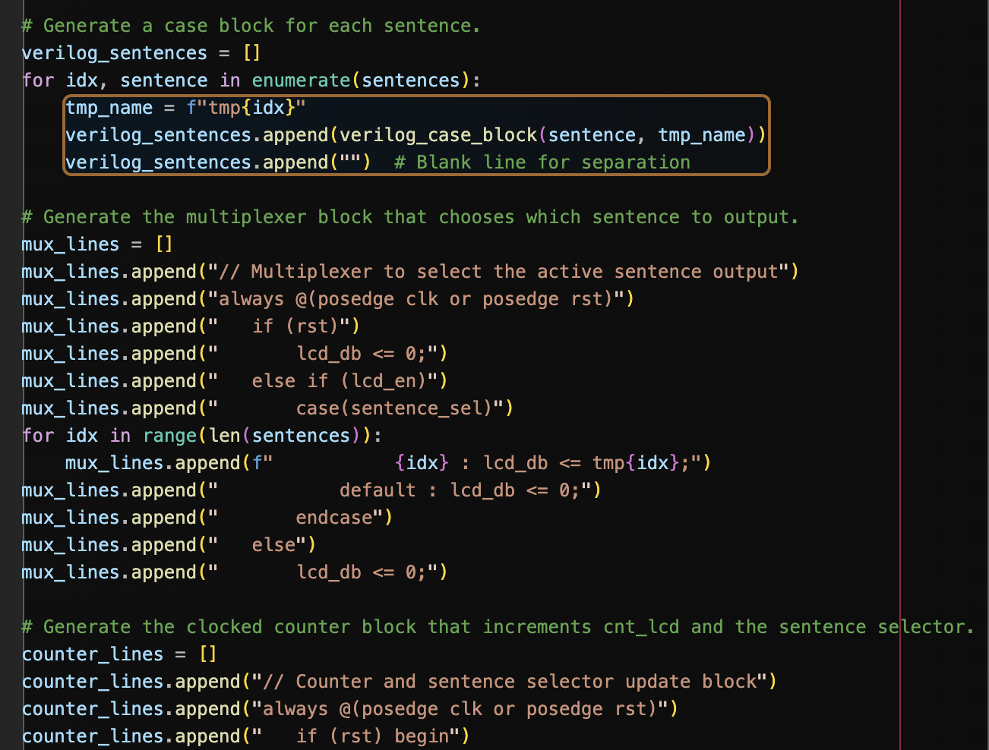
Script
Generating the case block for each character in the string
Generating the multiplexer for the temporary registers

Slide 5
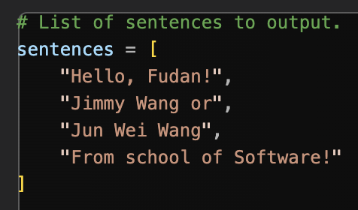
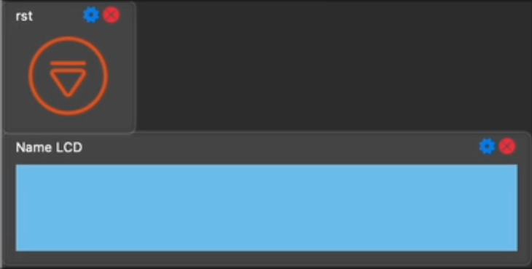
Experiment Results
Script Input
Rabbit Output

Slide 6
Experiment 2
Main topics
UDFE & Rabbit compiled on MacOS
SMIMS Engine
SMIMS VLFD Driver Reimplemented in Rust
FDE-CLI
I2C

Slide 7
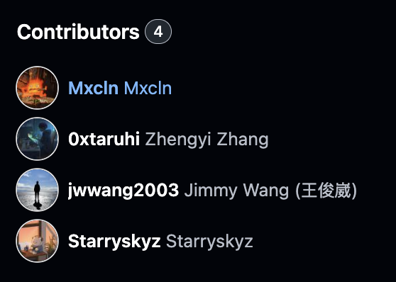
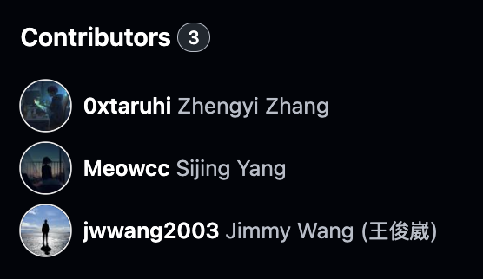
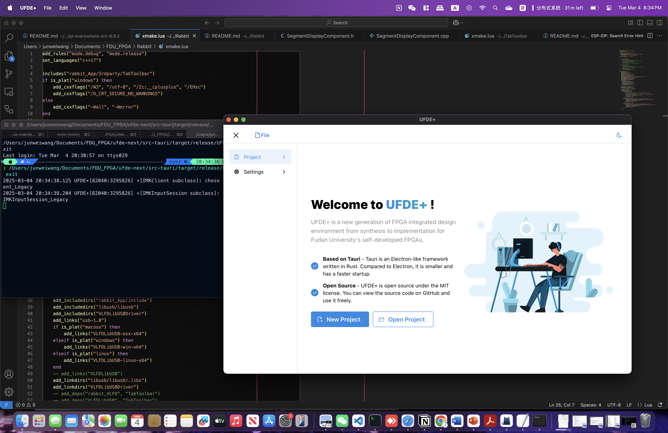
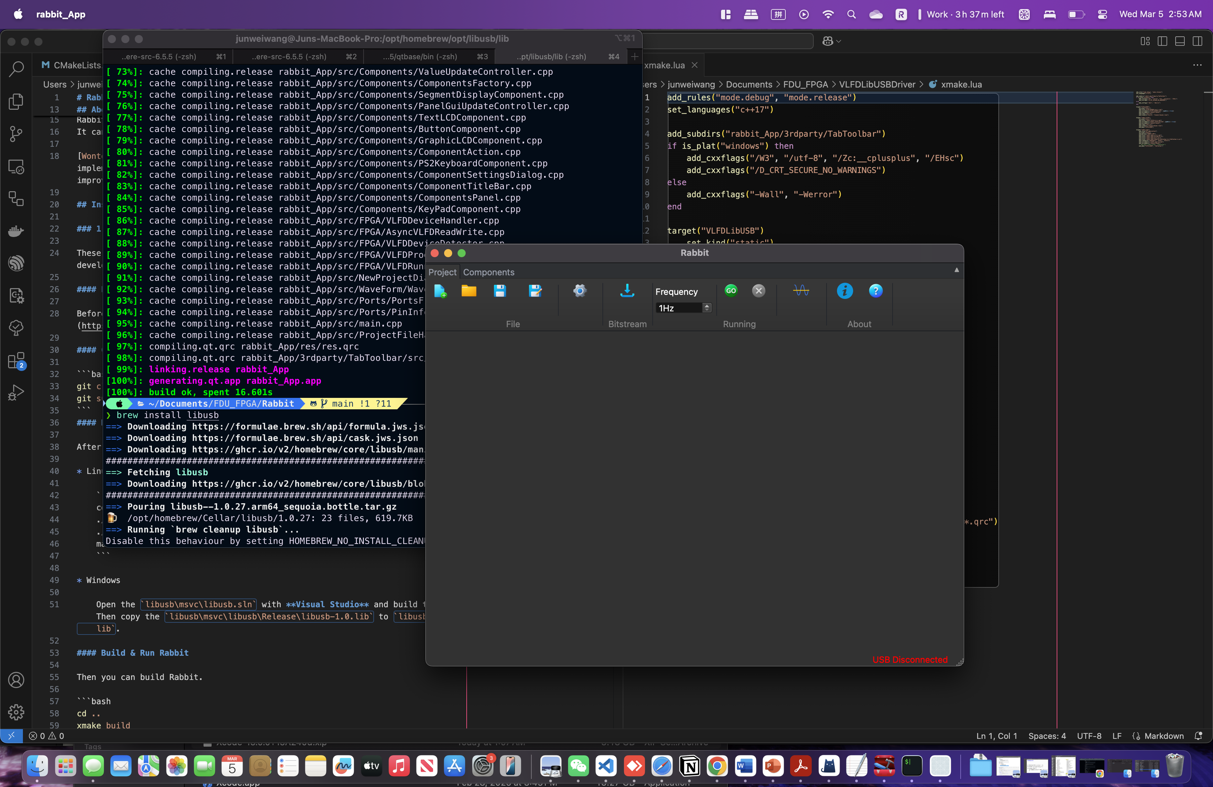
UFDE & Rabbit on MacOS (Arm)
UFDE compiled on MacOS
Rabbit Compiled on MacOS
Notes:
All the demos shown in this presentation is ran on my MacOS
(of course, generating the gate-level Verilog file, I still have to use a x86 environment for the DC flow on a virtual machine) And they are fully functional, except the bitstream download feature on Rabbit (for some reason it would cause a segmentation fault and is unresolved up to this day)

Slide 8
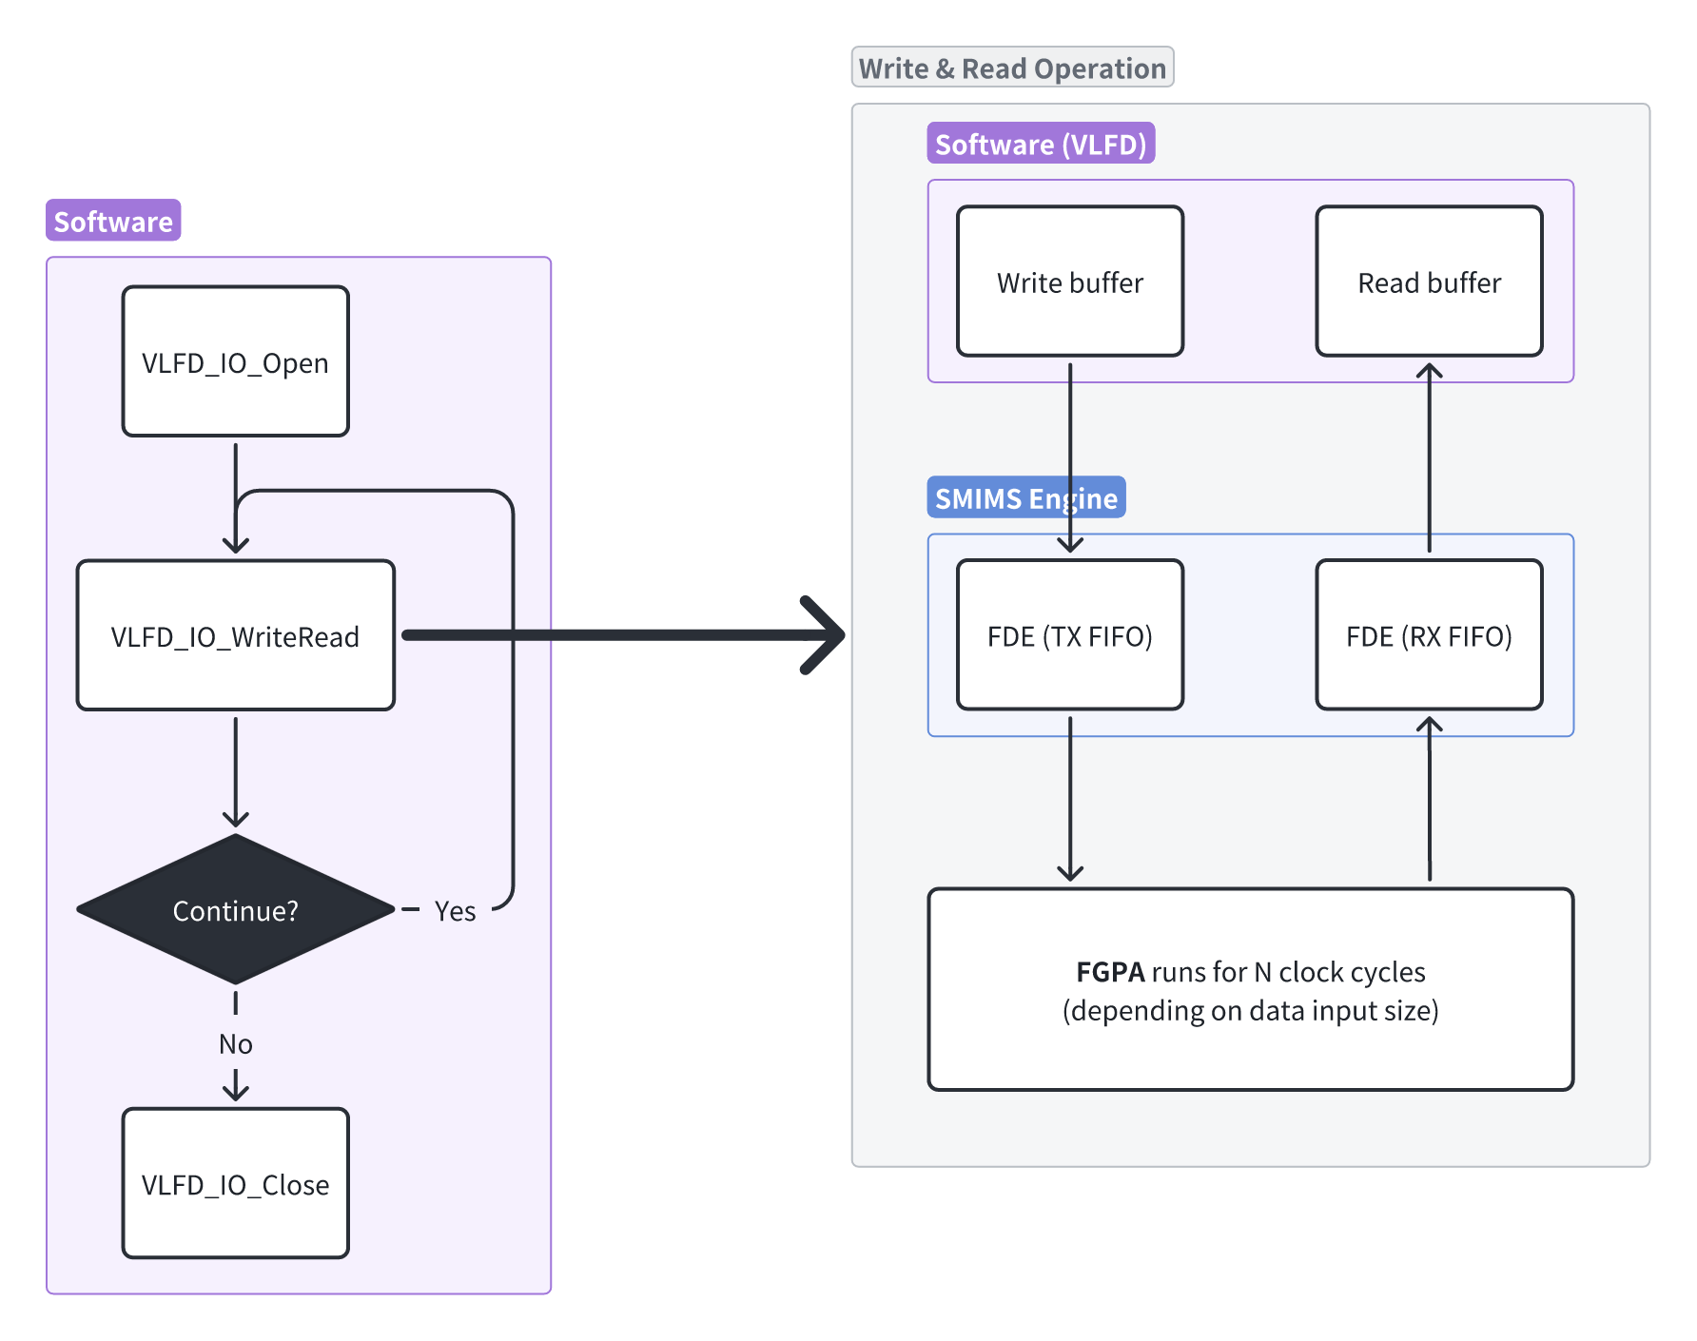
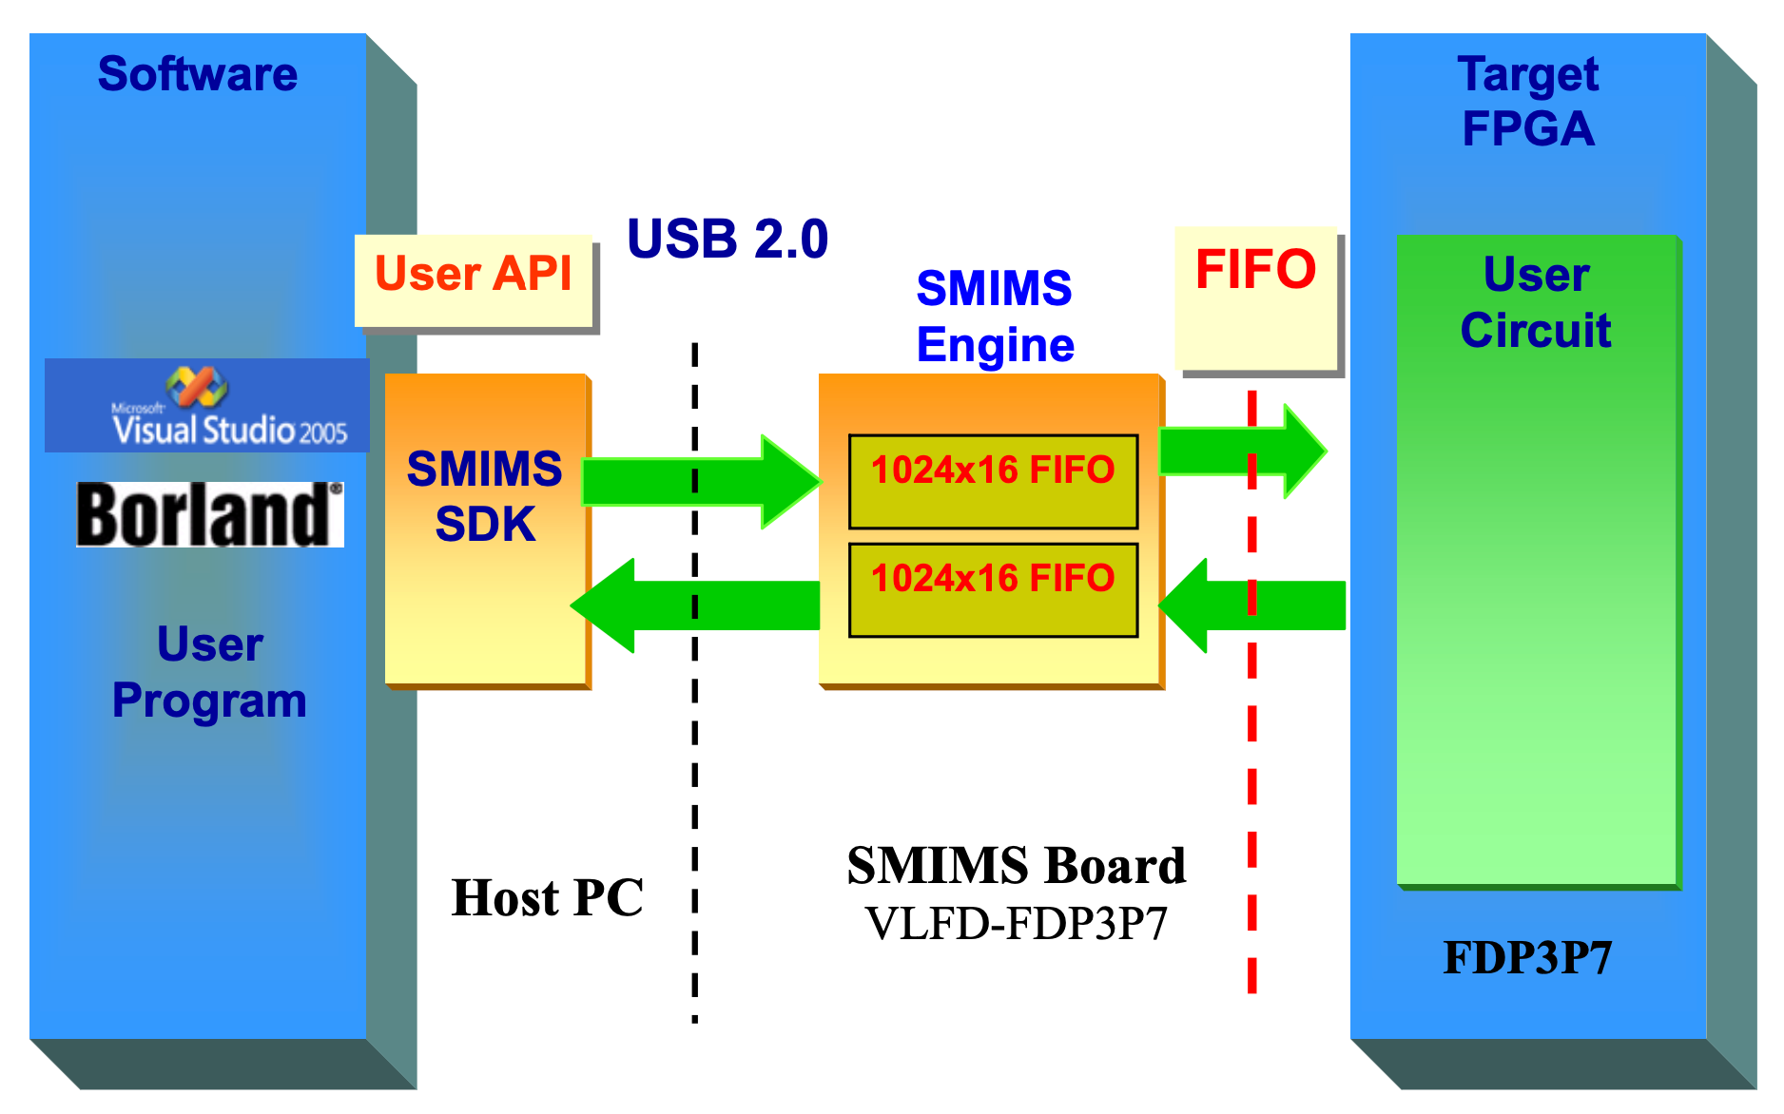
SMIMS Engine

Slide 9
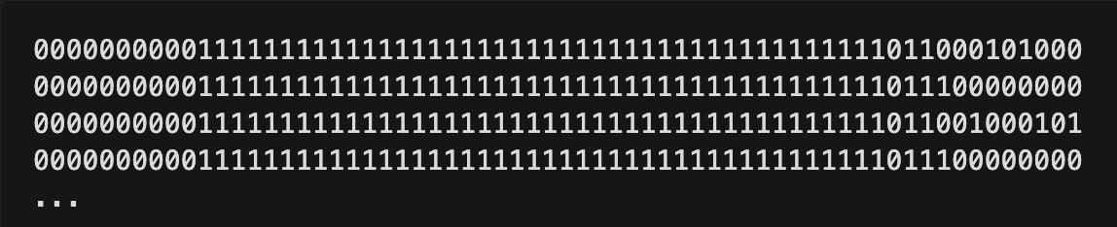
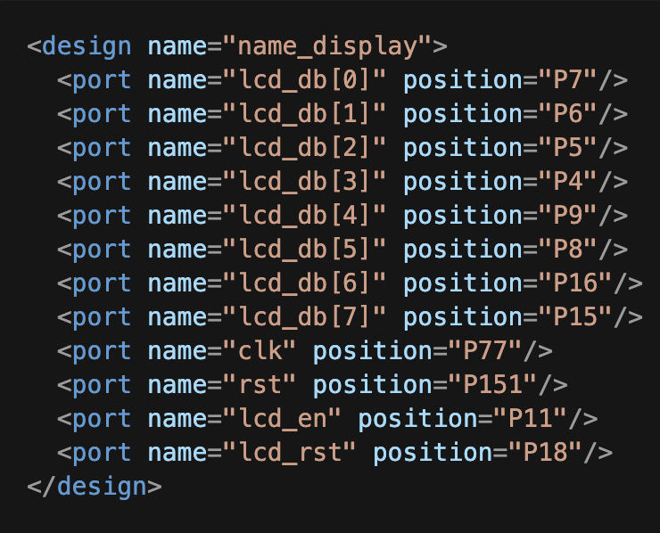
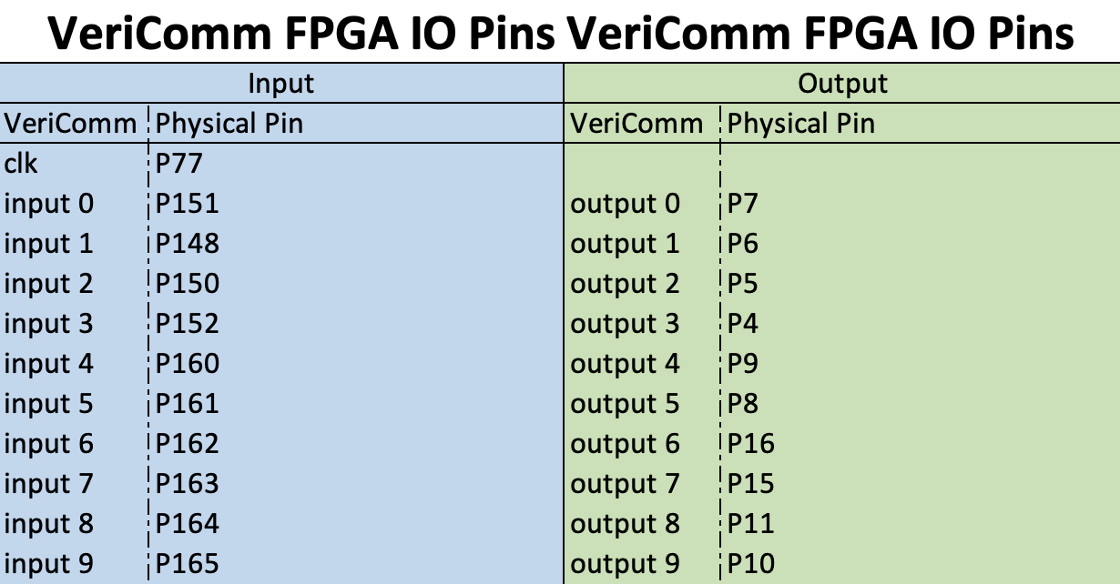
DEMO
Raw data from RabbitReadData.txt
indices mapped to one bit on the data read from the FIFO (little endian)
Mapping spreadsheet
lcd_db[0] ~ lcd_db[7] → output[0] ~ output[7]
rst → input[0]
lcd_rst → output[8]
Constraints .xml file
Notes:
Using the name display experiment as an example, lets try to make out what the stream of bits flowing in and out of The indices behind input or output can be mapped to a bit on the data read from the FIFO.
But note that on the data returned from the IO_WriteRead is in little endian, so its first byte of data starts from the right (or LSB).

Slide 10
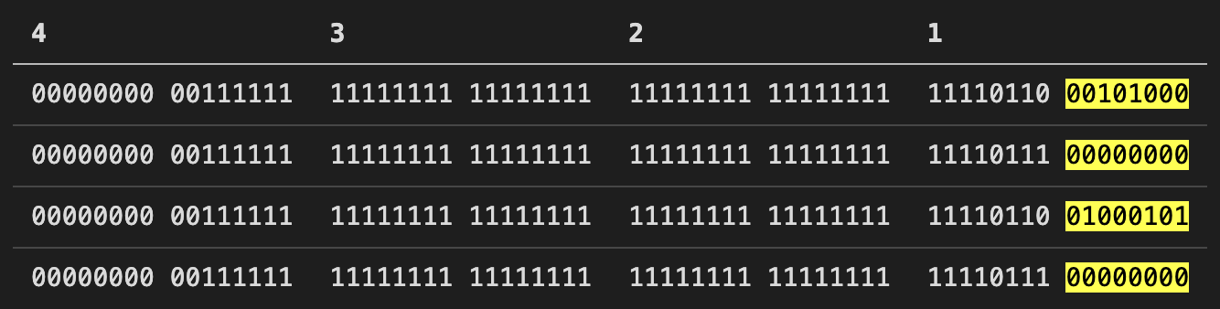
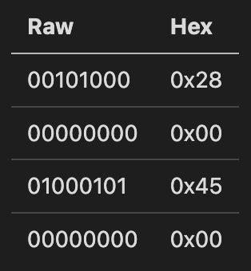
DEMO
Raw data from RabbitReadData.txt
lcd_db[0] ~ lcd_db[7] → output[0] ~ output[7]
rst → input[0]
lcd_rst → output[8]
H
e
…
Notes:
Now armed with the knowledge of the mappings from the
We can see that the first four samples start to spell out “H” and “e”, which is correct because the name display starts with “Hello, Fudan”

Slide 11
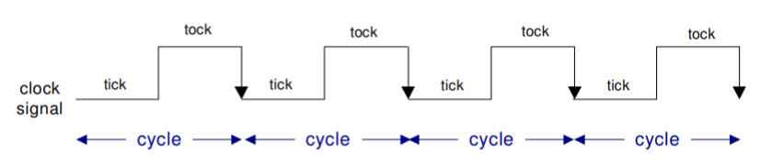
SMIMS Engine Summary
Main Critical Deliverables
Product launch
Software updates
Press release
Printed materials
Confidence Rating
5/5 confident that we will complete project on schedule
Clock signal reference image

Slide 12

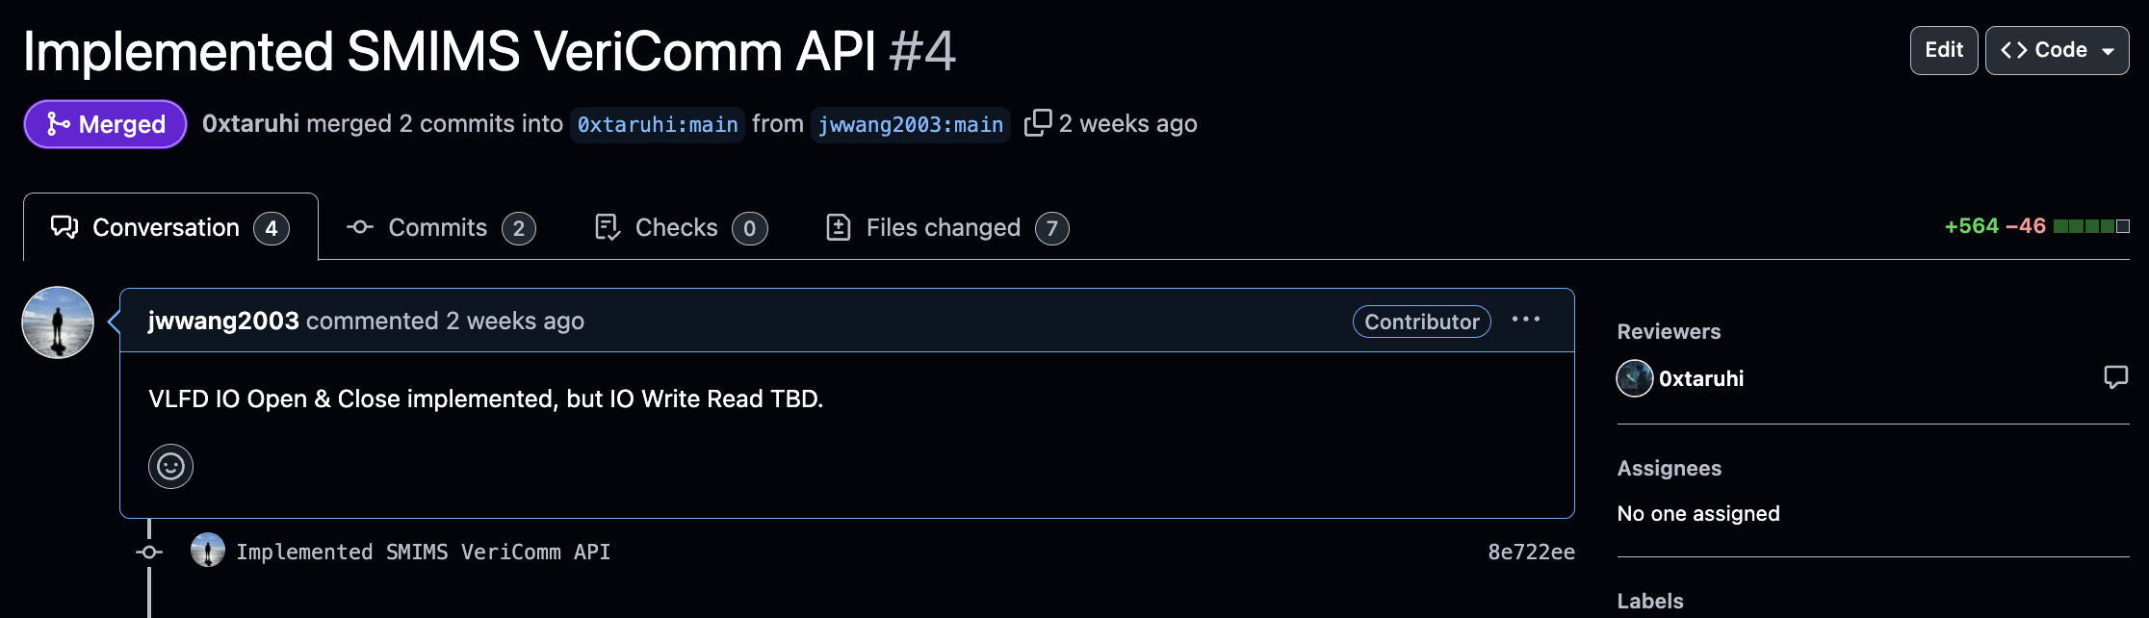
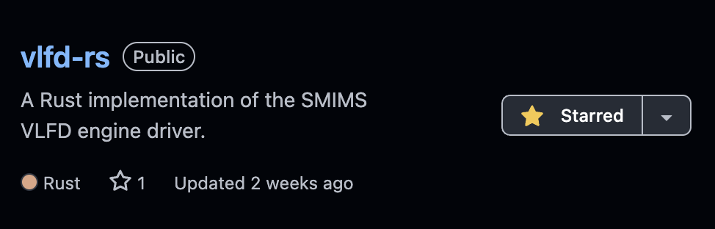

SMIMS VLFD Driver in Rust
https://github.com/jwwang2003/vlfd-rs
https://github.com/0xtaruhi/ufde-next/pull/4
Notes:
With the

Slide 13
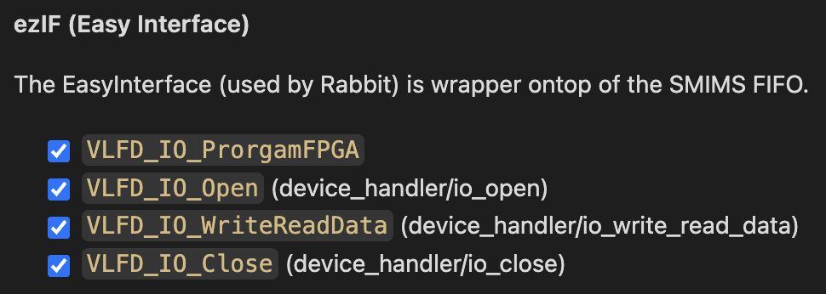
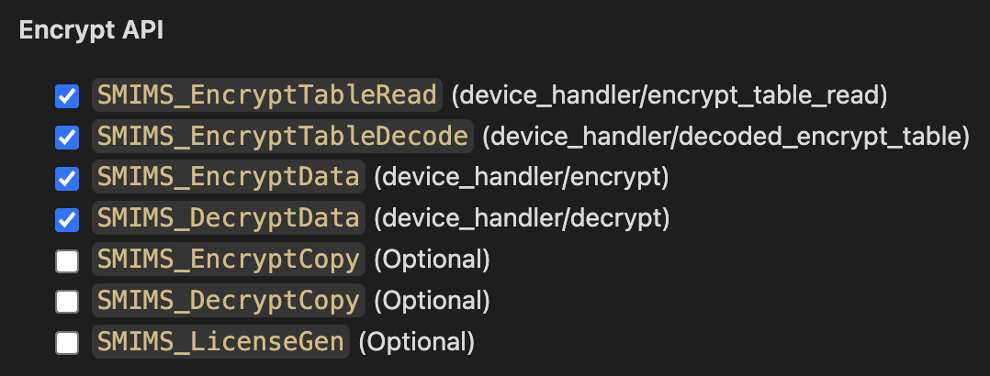
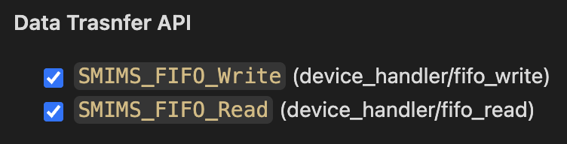
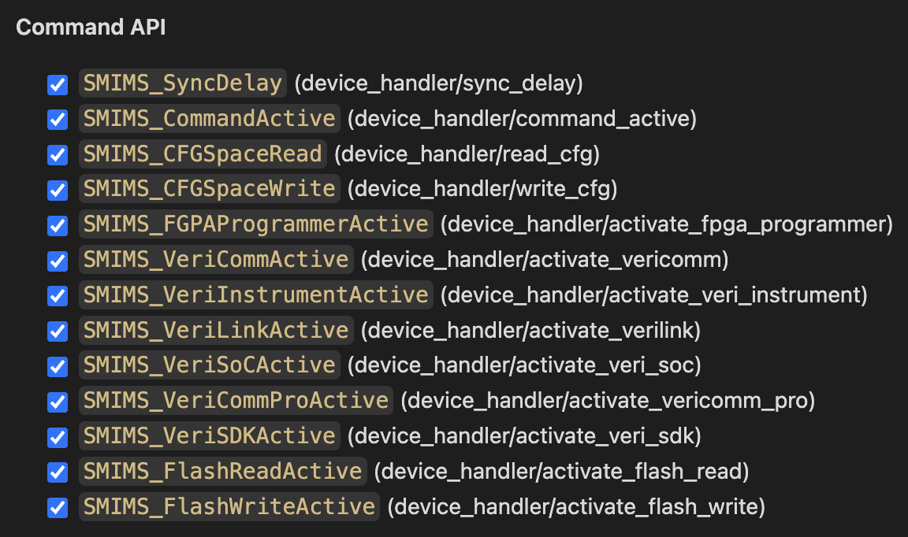
Features
Implementation Check List (ezIF)
Implementation Check List (Transfer API)
Implementation Check List (Encryption API)
and more…
Future Work
Finish implementing LicenceGen & serial functions
Device context (API natively support multi-device)
Handle asynchronous events (device unplug, etc.)
Handle errors (prevent segmentation faults)
Implementation Check List (Command API)
Notes:
Now, with a fully functional SMIMS driver implemented in Rust, we can build a lot of things easily because of how easy it is to develop with Rust than CPP.

Slide 14



C++ vs Rust VS JS
Aspect | C++ | Rust | JavaScript (TypeScript)
Type | Compiled, OOP | Compiled, Systems | Interpreted/Compiled, Dynamic
Memory Management | Manual (pointers) | Ownership model, no GC | Automatic Garbage Collection
Performance | Very High (system-level) | High (performance, safety) | Medium (depends on V8 engine)
Concurrency | Manual threads, parallelism | Safe concurrency (async/await) | Async with event loop
Ease of Learning | Hard | Moderate | Easy (TypeScript improves JS)
Tooling | Excellent (IDE support) | Excellent (Cargo, rustfmt) | Excellent (VS Code, NPM)
Ecosystem | Mature | Growing, strong for systems | Huge (Node.js, NPM)
Use Case | High-performance apps | Systems programming | Web development, Async I/O
Integration in Node.js | Native Addons (node-gyp) | FFI, WebAssembly | Native, main language for Node.js
Asynchronous Support | Manual handling (threads) | Advanced async/await | Native async/await, Promises
Notes:
I think Rust is a great programming language. I used to be a hardcore Typescript and NodeJS user, I also coded C++ but most of the time I would avoid it because of how complex things can get sometimes.
It took me around 3~5 days to learn Rust while I was re-implementing the SMIMS driver & I think it offers the best from both worlds:
With Rust, we can enjoy high performance systems programming, on par with C++, but we don’t need to stress about pointers & explicit memory management.
So, memory leaks are basically out of the picture.
Rust also has a package manager for libraries, similar to that of NPM from NodeJS, and I love it.
Compared to C++ which has various types of libraries (static, DLL, system libraries, etc.), It is much easier to ensure system cross-compatibility with Rust.
The ownership model was a bit of a learning curve but if you are familiar with pointers, you would quickly realize that its actually quite intuitive.
I also realized that if your Rust program compiles without errors, then most likely its going to function correctly, or at least without memory bugs or leaks. So, all in all, I think Rust is a great programming language to learn.

Slide 15
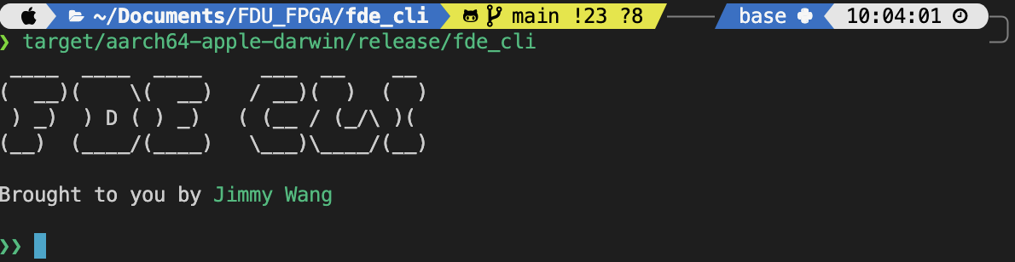
FDE-CLI
Features
Aims to offer a “GDB like” debugging experience
Manage multiple FDE boards
Debug SMIMS engine
Manage project files
Downloading bitstream & fine grain control over SMIMS engine FIFO
Almost everything Rabbit has to offer, except virtual components & GUI
Notes:
I introduce to you the FDE command line interface! (or FDE-CLI for short)
It:
Aims to offer a “GDB like” debugging experience
Manage multiple FDE boards
Debug SMIMS engine
Manage project files
Downloading bitstream & fine grain control over SMIMS engine FIFO
Almost everything Rabbit has to offer, except virtual components & GUI

Slide 16
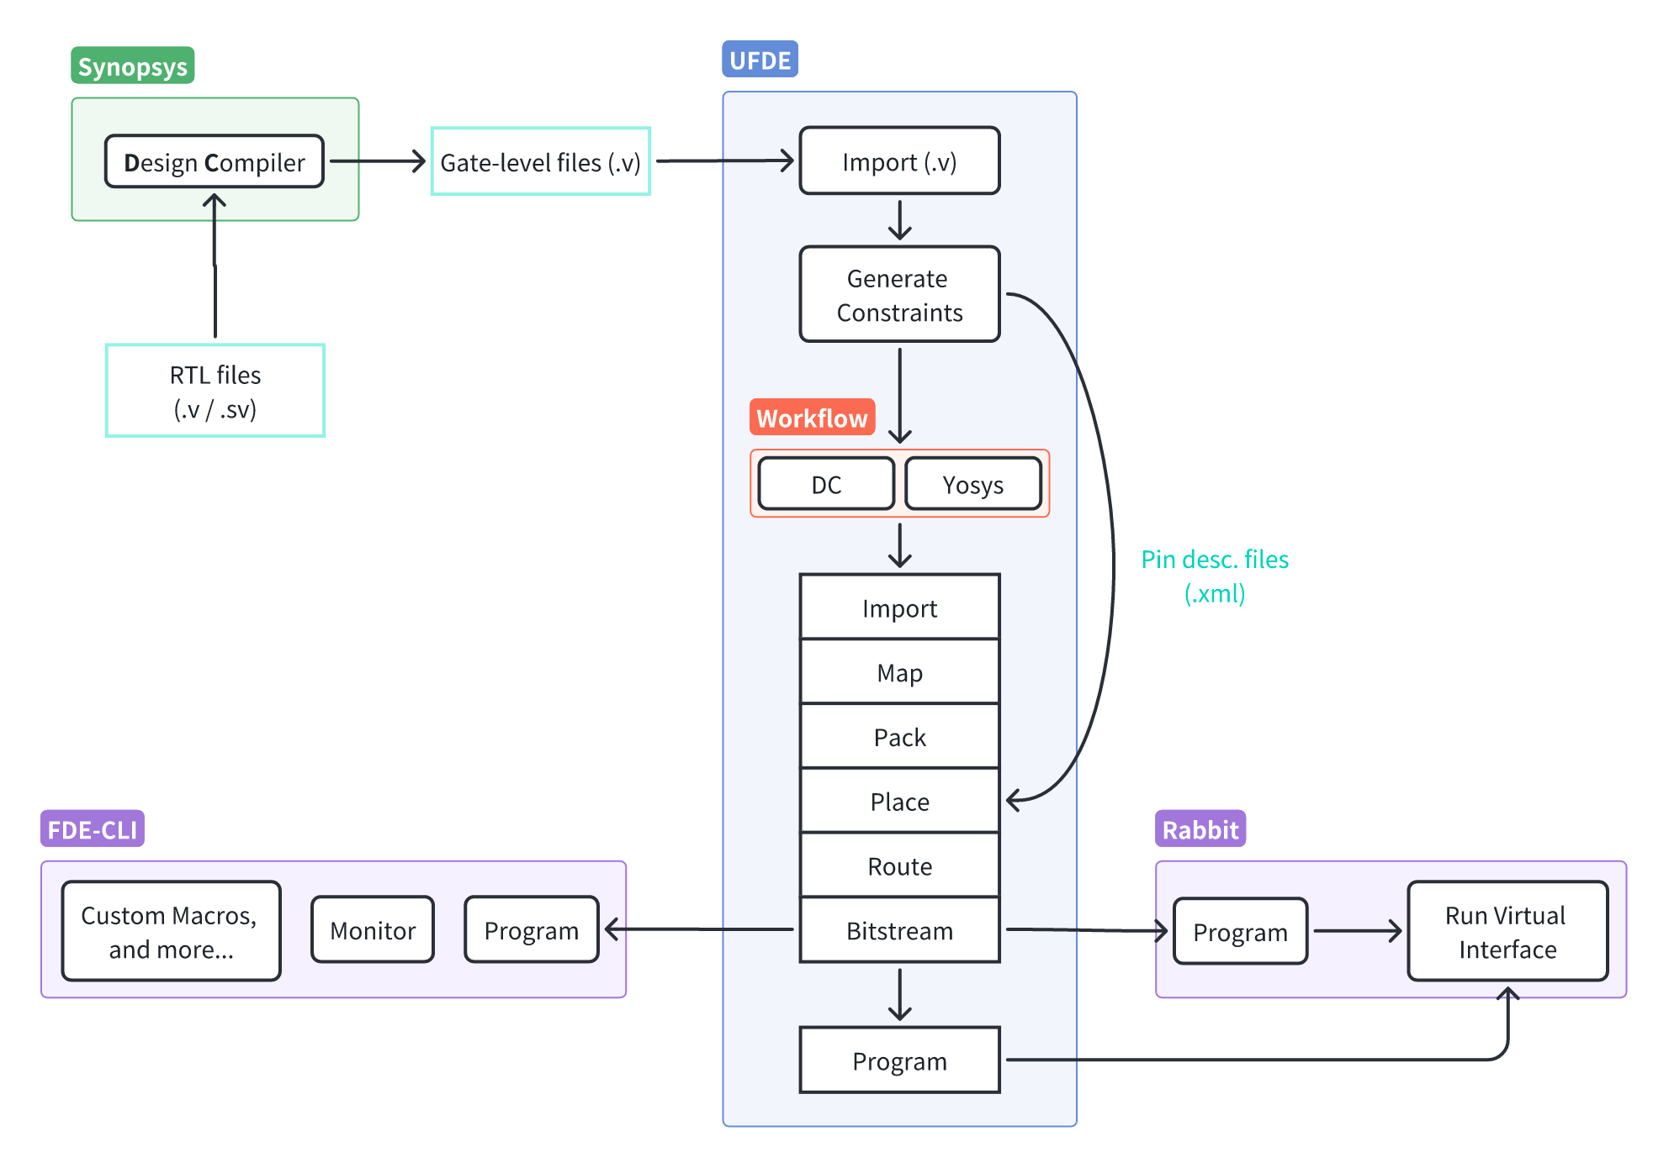
Limitations of Rabbit
Poor cross-platform compatibility
Virtual components on Rabbit are limited
No “fine-grain” control over IO on Rabbit
Not scriptable
What FDE-CLI offers?
Better cross-platform compatibility
SMIMS VLFD driver reimplemented in natively in Rust
More versatility in terms of the processing of IO data from SMIMS’s FIFO
Etc.

Slide 17
Inspiration
Product launch
Software updates
Press release
Printed materials
Confidence Rating
5/5 confident that we will complete project on schedule

Slide 18
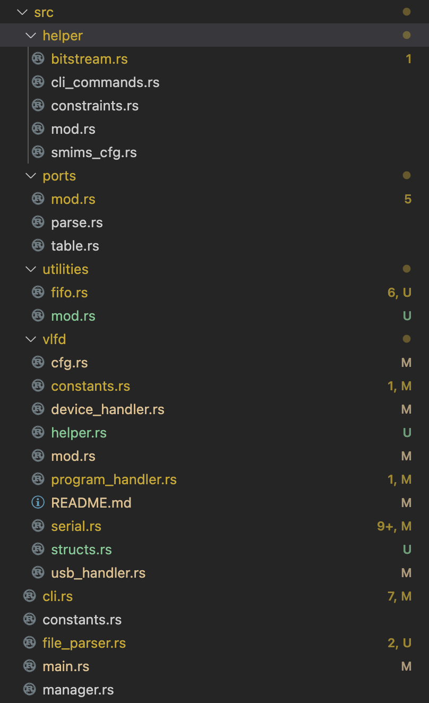
FDE-CLI Structure
Future to-do:
Multi-threading (to interact with multiple FDE boards at the same time)
Multi-threading to support polling data from a AFIFO
Support scripts (similar to DC’s .tcl file)
Better error handling
Handle asynchronous events (s.a. USB unplug)

Slide 19
FDE-CLI DEMO

Slide 20
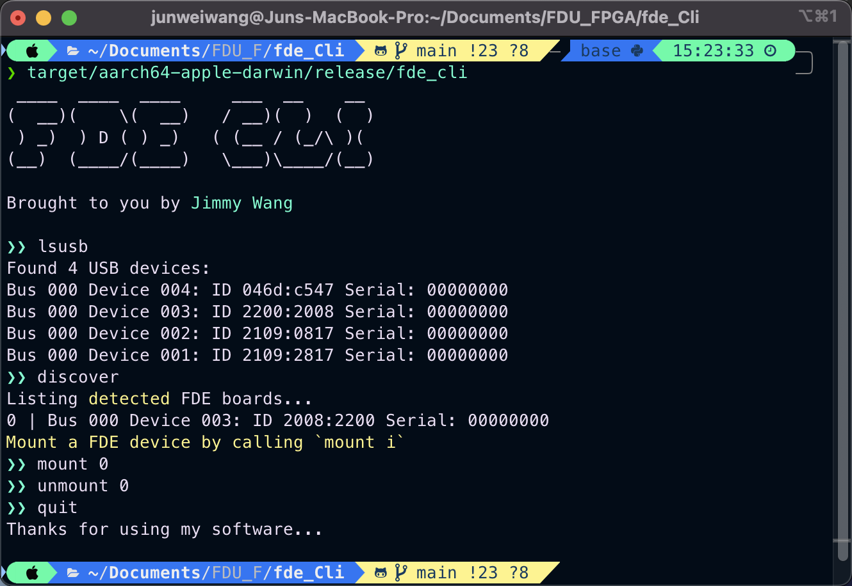
Discovery
FDE board discovery
FDE-CLI can recognize & differentiate multiple FDE boards
Each detected FDE board can be indexed (0~n boards connected)
Notes:
Because the current impe

Slide 21
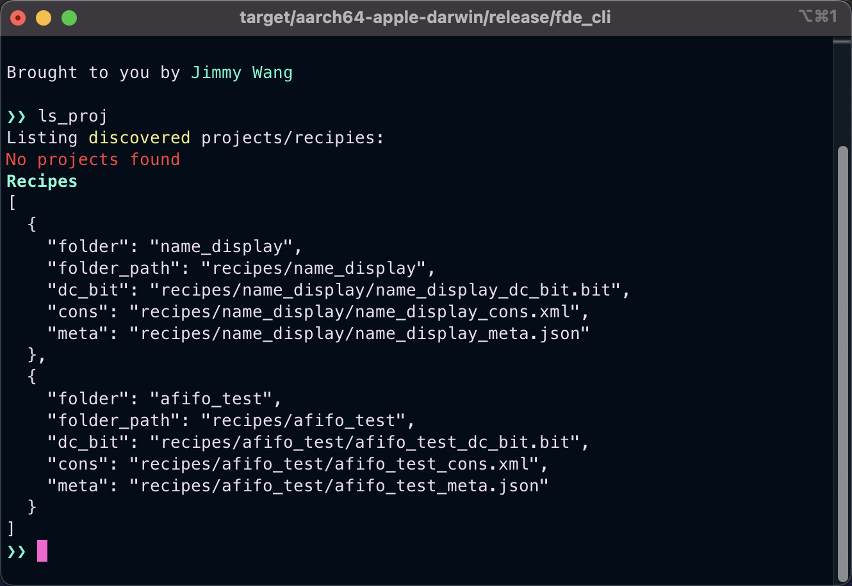
Projects & Recipes
Similar to UFDE & Rabbit
FDE-CLI has its own project management system
Projects refer to user imported projects
Recipes are built in project demos
In the future, projects/recipes can also have scripts in them

Slide 22
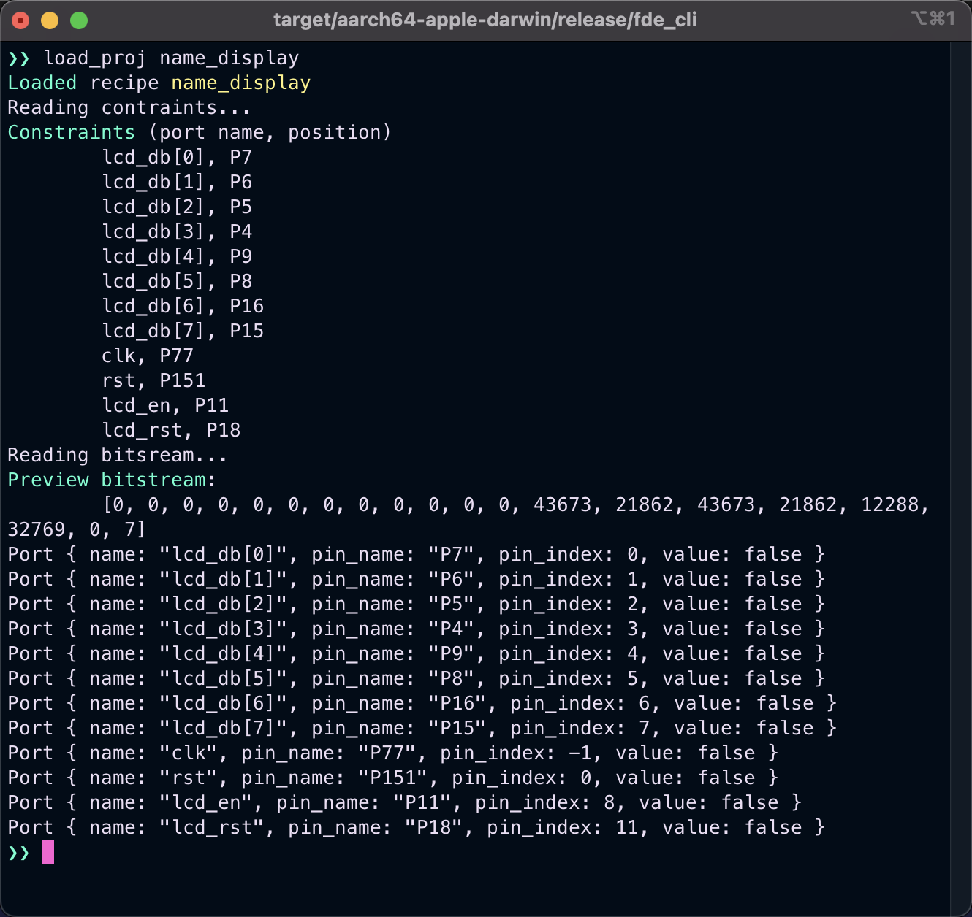
Loading a Project/Recipe
Interpreting constraints & detecting IO ports
FDE-CLI can parse and interpret constraint files & bitstreams
FDE-CLI has a regex mechanism that detects whether an IO port is a single data line or is part of an array
Useful later when observing how data changes

Slide 23
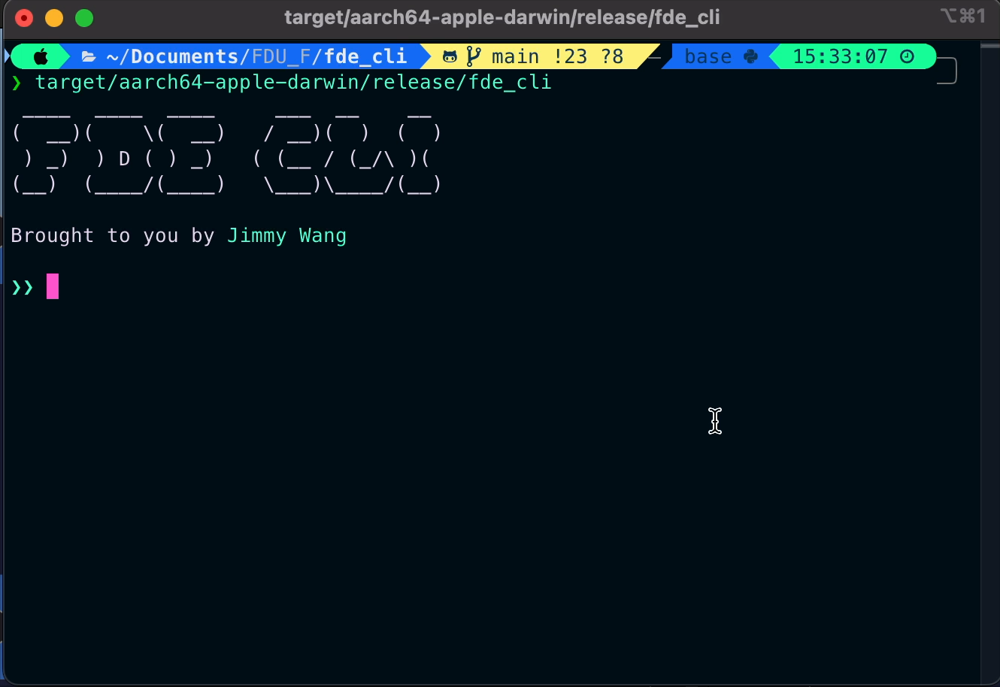
FDE-CLI DEMO Name Display
Objective
FDE device discovery
Loading a project/recipe
Programming a FDE board
Running for 4 cycles & printing the output

Slide 24
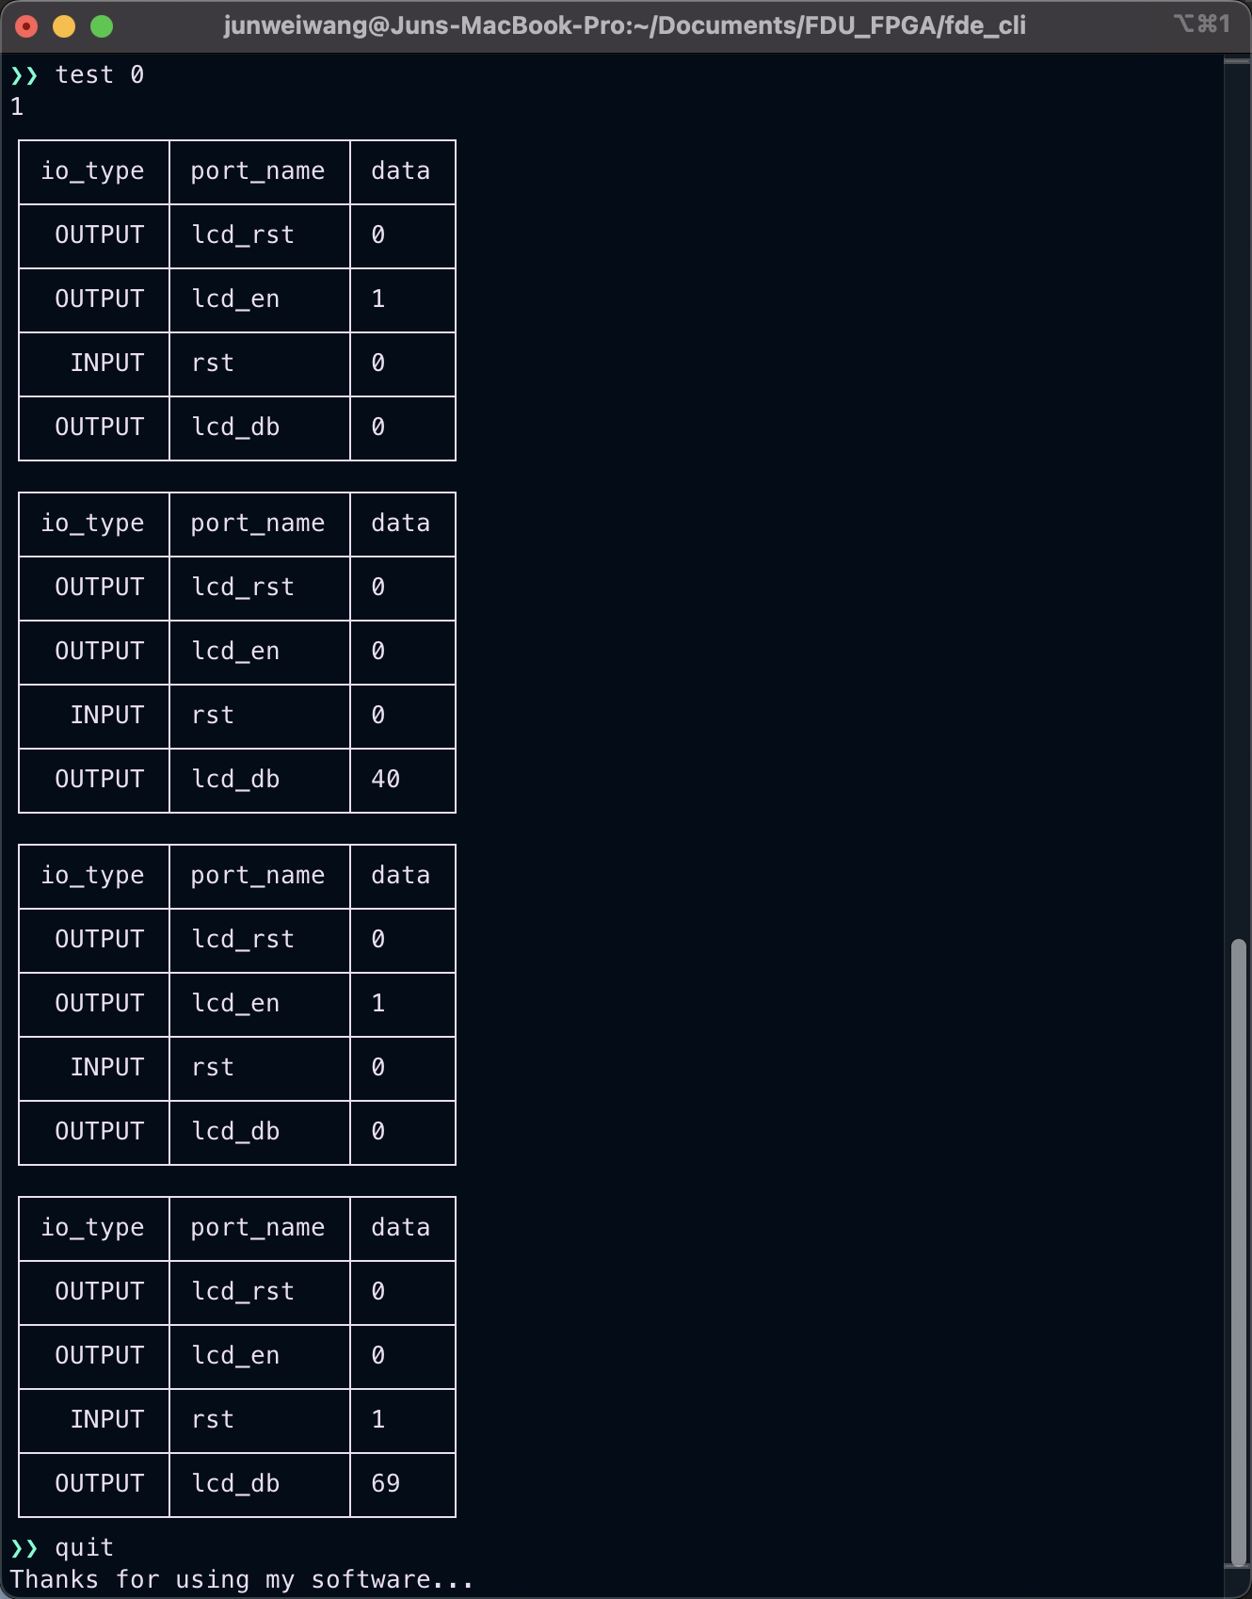
FDE-CLI DEMO Name Display
Explaination
40 = 0x20 (H)
Each table is the resulting IO state of each clock cycle
Notice how in these four clock cycles, we see “H” and ”e” being outputted on the data bus
We can expect to see “llo” if we run for 6 more cycles
69 = 0x45 (e)
Snapshot of output of the output of name display FDE CLI demo

Slide 25

FDE-CLI Future Plans
Future to-do:
Multi-threading (to interact with multiple FDE boards at the same time)
Multi-threading to support polling data from a AFIFO
Support scripts (similar to DC’s .tcl file)
Better error handling
Handle asynchronous events (s.a. USB unplug)

Slide 26
I2C (Inter-Integrated Circuit)
Features
Still in progress

Slide 27
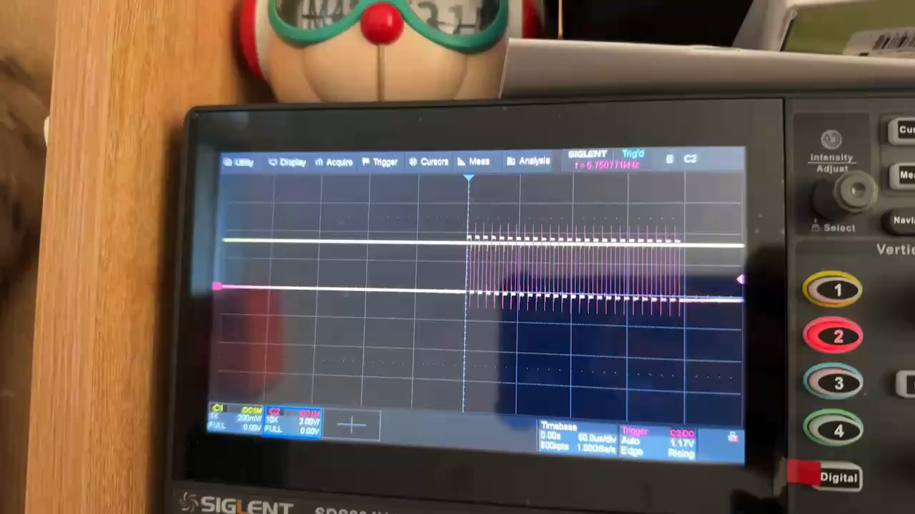
Growing Pains
Timing Issues
Qt::PreciseTimer & thread::sleep (Rust) suffer from precision issues
At high frequencies, we might observer jitters (fluctuations in timing)
Windows/MacOS is definitely not a real-time operating system (RTOS), and most Linux machines aren't either
Rabbit
Rabbit does not have any virtual component(s) for reading & writing (hex/binary data) to and from registers
No fine-control over the processing of data received & transmitted on every clock cycle
No scripting / automation
Notes:
As other students probably have experienced before, there are some incompatibilities between the output of the In the video clip, the bursty look of the signal can probably be attributed to:
The USB driver sending data in bulk
SMIMS FIFO is being read in bulk
Or both
Because Windows & MacOS are not RTOS, if the frequency is too high, we should not trust that the SMIMS clock is actually running at the defined frequency in equal intervals. Maybe the average clock rate is correct, but from my observations, they are definitely not equally spaced out.

Slide 28
Solution
Check on warehouse update
Fix software issues
Finish drafting solution
Resolve budget question
Goals for Next Review
Mirjam Nilsson will tackle and resolve the goals by next meeting
Action Plan Review

Slide 29
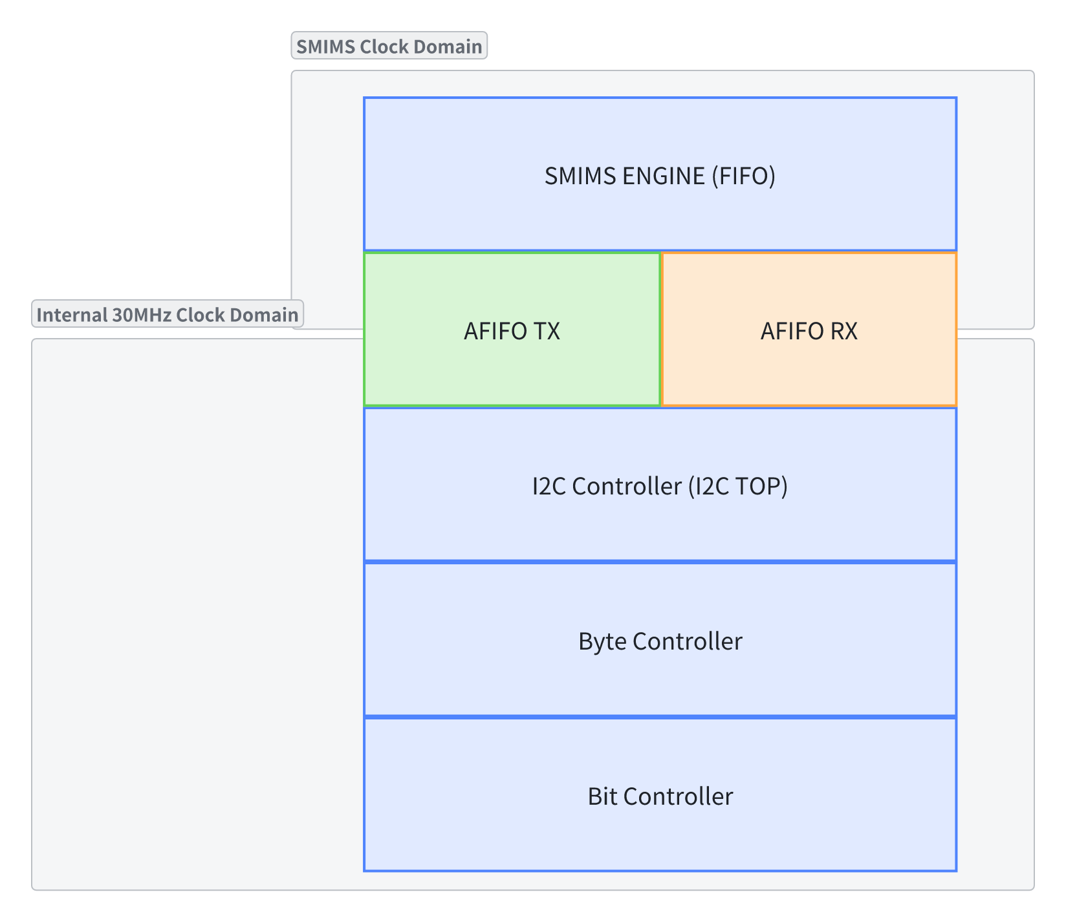
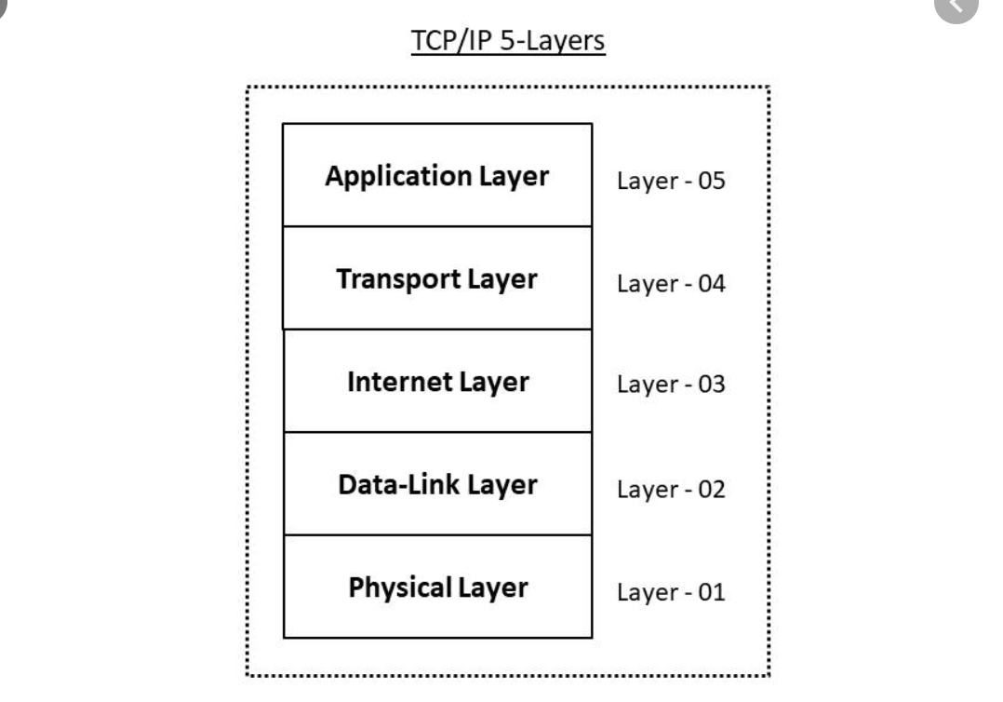
I2C Module Topology
Notes:
Because of the time constraint and I got quite sick the past week, the I2C controller & byte controller is not done yet unfortunately.

Slide 30
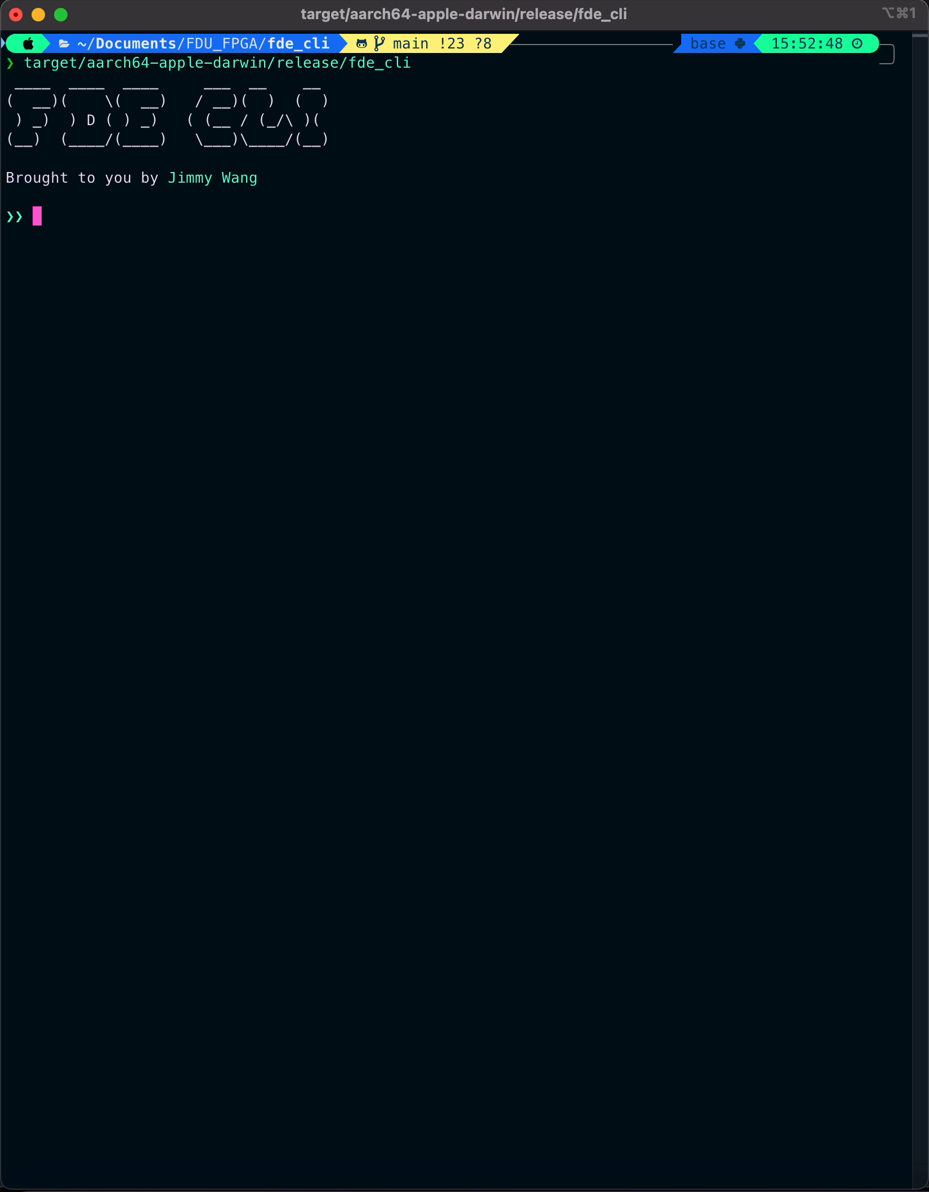
FDE-CLI DEMO AFIFO
Objective
Demo an asynchronous FIFO implemented on FDE
Two AFIFOs (TX & RX) linked to each other
Foundation for I2C module in the future
Clock-domain FIFO
SMIMS engine clock based on FDE-CLI
Internal 30MHz clock driving the I2C module
Write & read “1”, “2”, “3” to & from the AFIFO

Slide 31
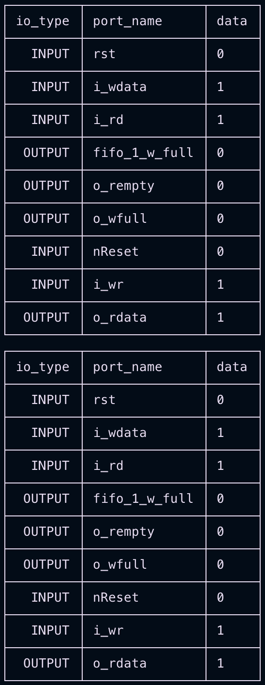
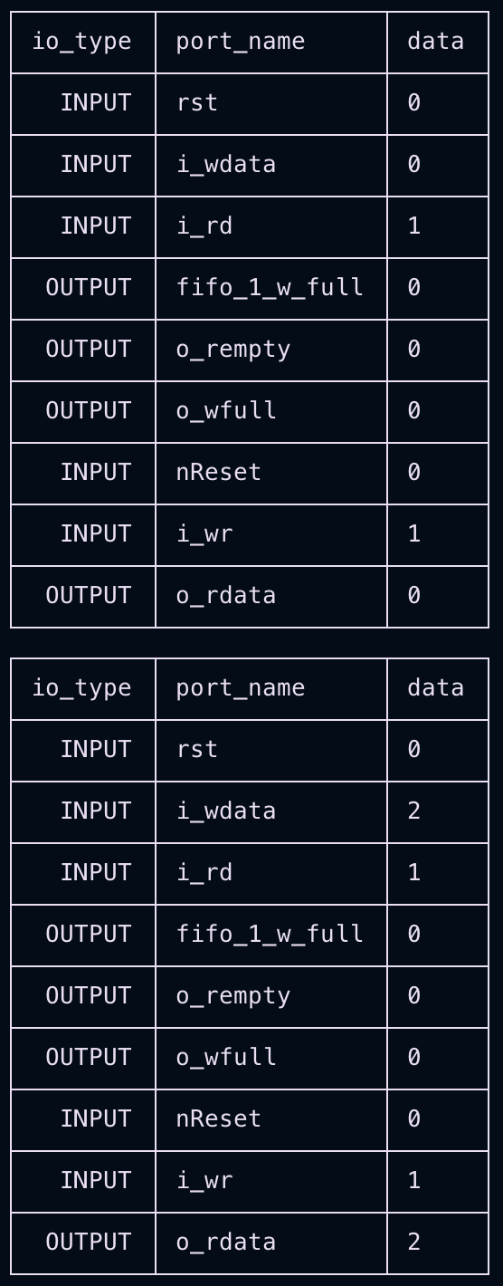
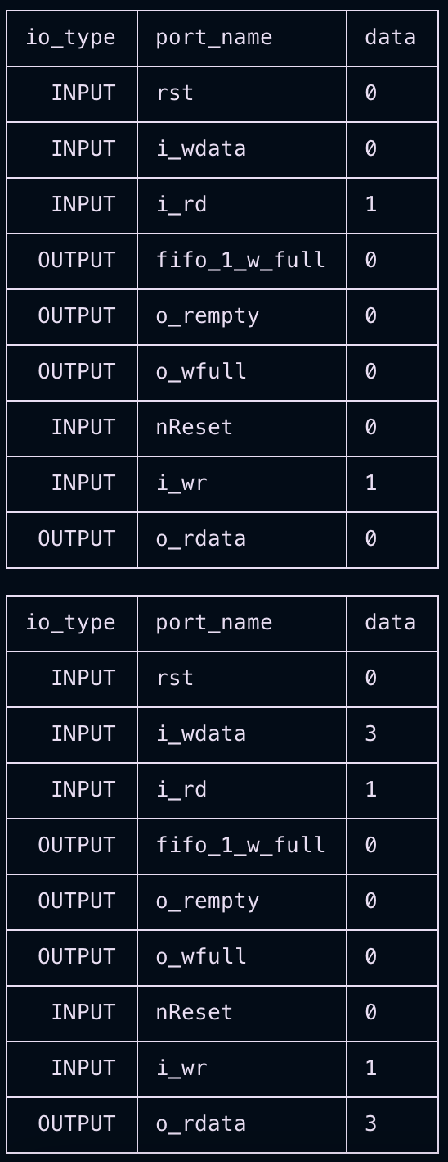
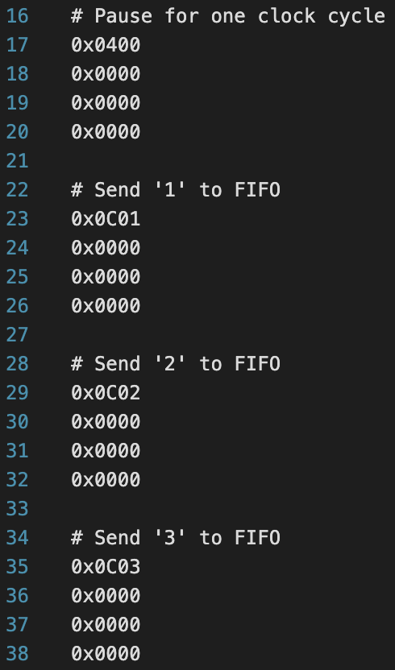

Slide 32
Bit Controller

Slide 33
Projection Of Costs
$14,000 projection for project
Main source from angel investors
Cost Overruns
$2,000 over budget
Closed gaps in communication with staff to present future budget issues
Project can track to remain on budget based on planning and current projections

Slide 34
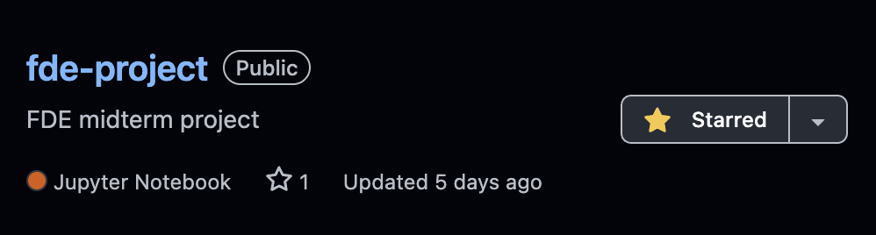
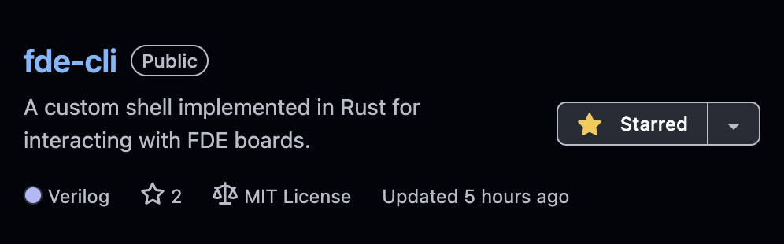
Open source
FDE Project
FDE-CLI
VLFD-RS
https://github.com/jwwang2003/fde-project
https://github.com/jwwang2003/fde-cli
https://github.com/jwwang2003/vlfd-rs
Notes:
To end if off, all my projects are open source on GitHub.

Slide 35
Thanks For Listening

